Slide 1
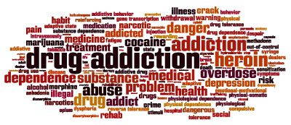
İlaçların Kötüye Kullanımı
Madde Bağımlılığı
Prof. Dr. Esra SAĞLAM

Slide 2


Louis Menand
His book “The Metaphysical Club” was awarded the 2002 Pulitzer Prize for history and the Francis Parkman Prize from the Society of American Historians.
Professor of English at Harvard University; Graduate Center of the City University of New York; Queens College Princeton, Columbia; University of Virginia School of Law
«Yaşam her bakımdan, kelimenin tam anlamıyla biyolojik bir temele sahiptir; biyolojik olarak mümkün olamayan hiçbir şey var olamaz»
…televizyonun,çikolatanın, video oyunlarının, kokainin, vibratörün, saunanın, çapraz bulmacanın, reality şovların, romanın ya da buna benzer şeylerin icadı ile birileri dünyayı yeni hazlarla tanıştırabilir…
Önemli insanı hazların birçoğu evrenseldir.
İnsanlar uyarılmaktan keyif alır.

Slide 3
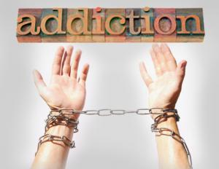
MADDE BAĞIMLILIĞI
Santral sinir sistemini (SSS) etkileyen bir maddenin
    Keyif verici etkilerini duyumsamak
    Yokluğundan kaynaklanabilecek huzursuzluktan sakınmak için,
Maddeyi devamlı yada periyodik olarak alma arzusu ile kendisini gösteren psikolojik ve somatik bir hastalıktır.
Hastalığın karakteri:
  Dürtüsel, önüne geçilemeyen tekrarlayan madde kullanımı davranışı
  Olumsuz sonuçlara rağmen maddeyi kullanmaya devam etme
  Beyin hücresel yapısında ve fonksiyonlarında kalıcı değişiklikler

Slide 4

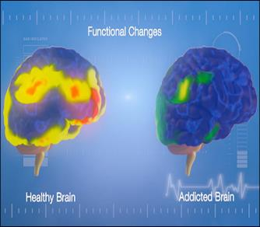
MADDE BAĞIMLILIĞI
Bağımlılık, zararlı sonuçlara rağmen, zorunlu ilaç arayışı ve kullanımıyla karakterize kronik, tekrarlayan beyin hastalığı olarak tanımlanır.
Madde beynin yapısını ve çalışma şeklini değiştirdiği için beyin hastalığı olarak kabul edilir.
Bu beyin değişiklikleri kronikleşebilir ve patolojik davranış bozukluklarına yol açabilir.

Slide 5
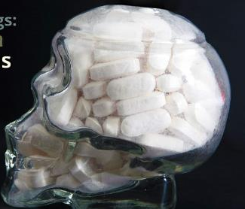
BAĞIMLILIK YAPAN MADDELER
Santral sinir sisteminde psişik stimülasyon veya depresyon oluşturan psikoaktif maddelerdir.
    Algılama,
    Duygu durum,
    Mental durum,
    Davranış ve motor fonksiyonlarda
bozukluk yaparlar.

Slide 6
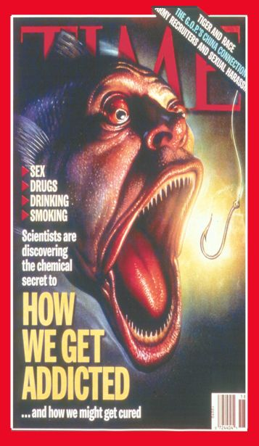

İnsan Niçin Madde
Bağımlısı Olur?
Madde Bağımlılığı
Beyindeki Motivasyon
ve Zevk Alma
Merkezi İle Bağlantılıdır.
Notes:
Why do drugs make people feel good or feel better—because of what they do to their brain. Drugs exert their effects largely on the motivation and pleasure pathways of the brain.

Slide 7
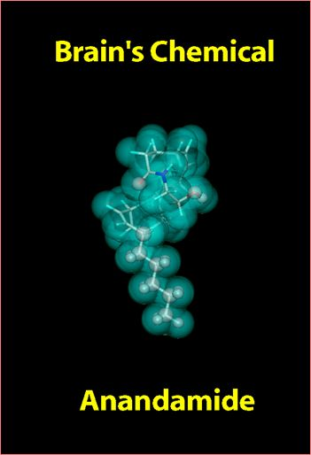
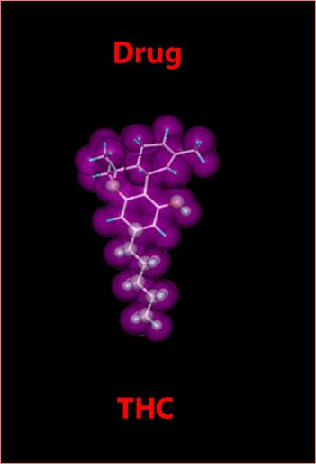
Madde beyindeki ‘düzenbaz’ mesajcıdır.
Notes:
How are drugs able to affect brain chemicals? Often, the chemical structure of drugs is similar to brain chemicals or neurotransmitters. Similarity in structure allows them to be recognized by neurons and to alter normal brain messages. Illustrated in this slide is THC, the active ingredient found in marijuana. It’s chemical structure is highly similar to anandamide, which is involved in a variety of functions including regulation of pain, appetite, memory, and mood.

Slide 8
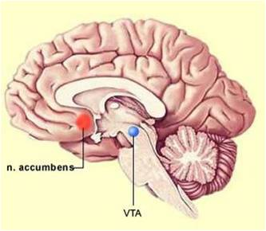
Ventral ön beyin ile ventral orta beyini birbirine bağlayan bir halkanın maddelerin ödüllendirici (keyif verici) etkileri ile yakın bir ilişkisi olduğu iyi bilinmektedir.
Mediyal önbeyin demeti olarak da adlandırılan bu yol ventral tegmental alan ve hipotalamus ile septum ve nükleus akkumbensi birbirine bağlar ve büyük ölçüde miyelinli liflerden oluşmuştur.
Bu lifler dopaminerjik, noradrenerjik ve serotonerjik özelliktedir.
Ac

Slide 9
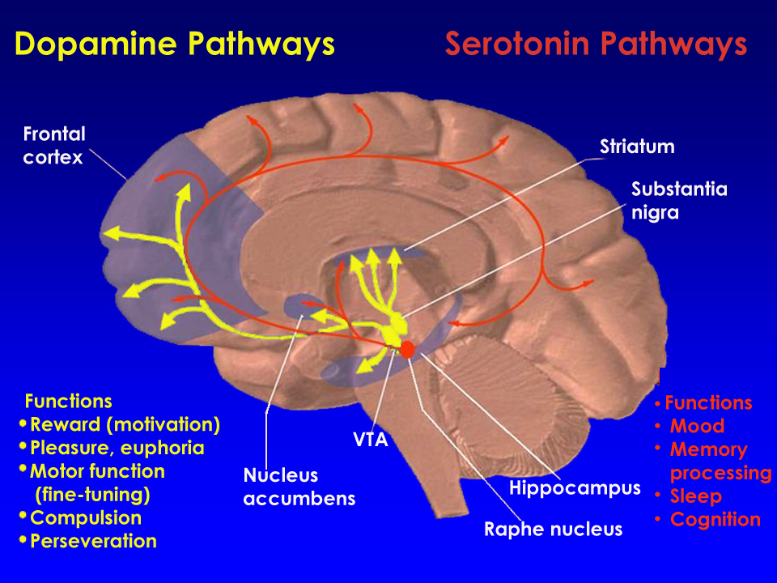
Notes:
Brain pathways affected by drugs of abuse. The dopamine and serotonin pathways are two brain systems affected by drugs of abuse. They are illustrated here. By altering activity in these pathways, abused substances can influence their function. Dopamine neurons (shown in yellow) influence pleasure, motivation, motor function and saliency of stimuli or events. Serotonin (shown in red) plays a role in learning, memory, sleep and mood.

Slide 10
Madde Bağımlılığ İle İlgili Nörotransmitter Sistemlar
En önemli rol dopaminin olsa da diğer nörotransmitter sistemlerin de bu hikayede rolü vardır.
  Dopamin
    Zevk alma, pozitif pekiştiri
  Noradrenalin
    Anksiyete, stimülasyon
  Opioid
    Zevk alma, keyf duygusu
  Serotonin
    Duygu durum ve uykuyu düzenler
  Glutamate
    Öğrenme ve hafızadan sorumludur.
Notes:
Dopamine is an important brain chemical in drug abuse and addiction, but other brain systems and brain chemicals are also involved. Serotonin and glutamate neurotransmitter systems, for example, are among those affected. These neurotransmitters are important regulators of mood, sleep, learning and memory, and more.

Slide 11
Reinforcement: Neurochemical systems
Glutamate
Excitatory Input
Enkephalin or
Dynorphin
Inhibitory Neuron
κ Opioid
Receptors
Dopamine Receptors
Enkephalin
Inhibitory
Neuron
Dopamine Neuron
GABA
Neuron
μ Opioid
Receptors
REWARD
GABA-A Receptors
GABA Inhibitory Feedback
GABA
Inhibitory
Neuron
Presynaptic
Opioid
Receptors
(μ, δ?)
Ventral Tegmental Area
(VTA)
Nucleus Accumbens
(NAc)
Notes:
Alcohol: Neurochemical systems
This is a diagram of a dopamine neuron (in yellow) originating in the VTA and projecting into the nucleus accumbens. These dopamine neurons are regulated by a variety of neurotransmitter systems:
-excitatory NMDA systems (red)
-inhibitory GABA neurons (green)
-opioid neurons and receptors (blue)
Alcohol is postulated to act by facilitating GABA-A function, by interacting with the GABA-A receptor, but at a site different from the GABA binding site or the benzodiazepine binding site. This leads to the activation of the VTA dopamine neuron.

Slide 12
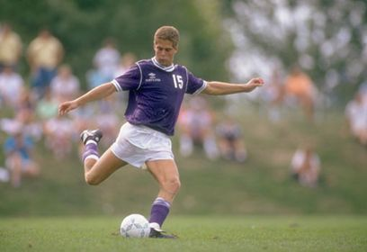

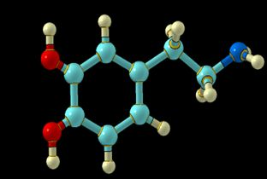

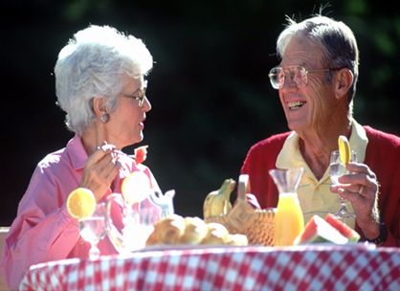
Dopamine
Hareket
Heyecan
Bağımlılık
Keyf&iyi olma
Notes:
Dopamine is a brain chemical involved in many different functions including movement, motivation, reward — and addiction. Nearly all drugs of abuse directly or indirectly increase dopamine in the pleasure and motivation pathways and in so doing, alter the normal communication between neurons.

Slide 13
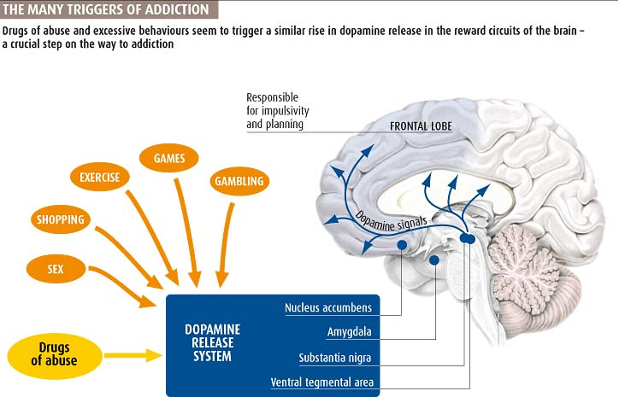

Slide 14
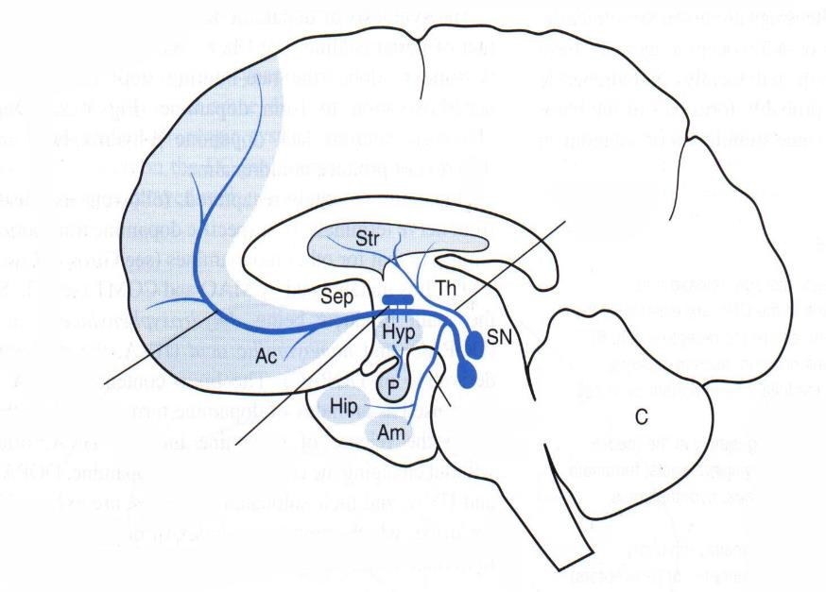
DOPAMİNERJİK YOLAKLAR VE ÖDÜL SİSTEMİ
Nigrostriatal
yolak
Mezokortikal
yolak
Mezolimbik
yolak
Tubero-hipofizyal
yolak

Slide 15
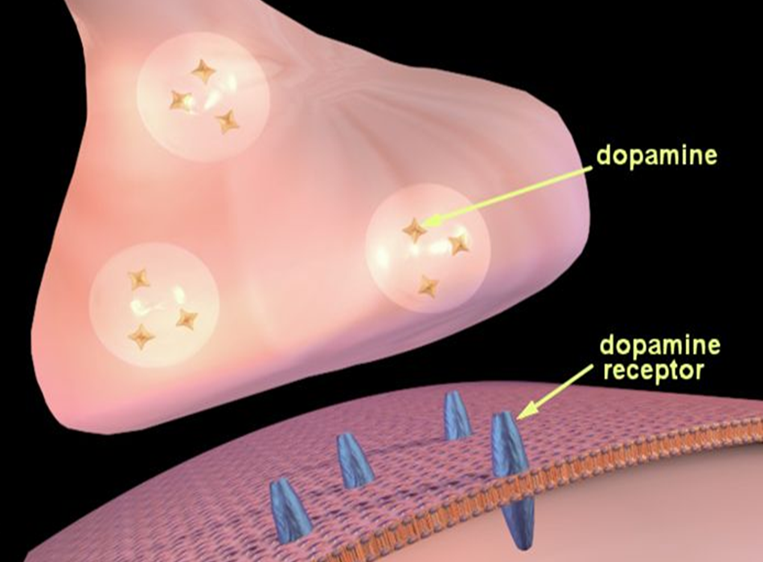
Notes:
This slide and the one that follows show how neurotransmission works specifically for dopamine. What is schematically illustrated in this slide is a nerve terminal (top), the synaptic cleft or space between the neurons, and the post-synaptic or receiving portion of a dendrite on a neighboring neuron. Dopamine is contained in vesicles (round storage sites) in the nerve terminal; dopamine receptors are present on the receiving (bottom) neuron.

Slide 16
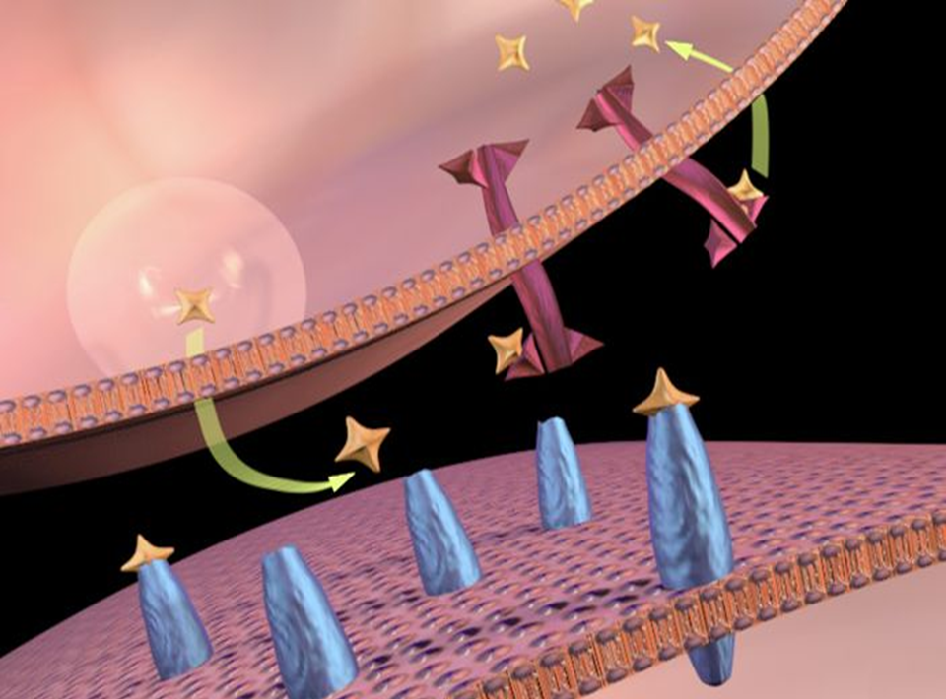
dopamine
transporters
Notes:
When a signal comes down the axon, dopamine (shown in orange) is released into the synapse. It then crosses the synaptic cleft to the second neuron, where it binds to and stimulates dopamine receptors (shown in blue), generating a signal in the second neuron. The dopamine is then released from the receptor and crosses back to the first neuron where it is picked up by dopamine transporters (reuptake molecules; shown in purple) for re-use.

Slide 17
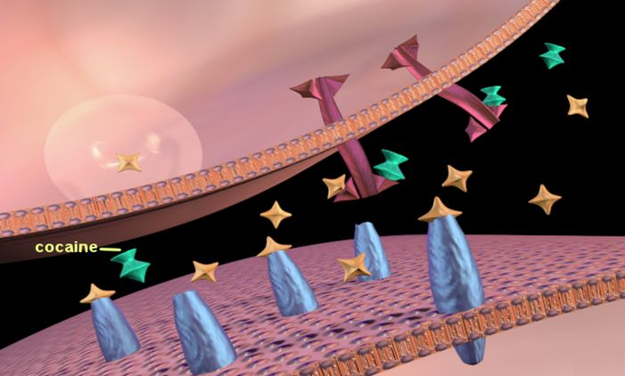
Notes:
But what happens when a person takes a drug? This slide shows how cocaine is able to alter activity in the synapse. Cocaine (shown in green), attaches to dopamine transporters (shown in purple), thereby blocking dopamine from being taken back up by the first neuron. Thus dopamine can continue to stimulate (maybe over-stimulate) the receptors of the second neuron because it remains in the synapse for a longer period of time. This duration of stimulation and amount of dopamine in the synapse is far greater than what normally occurs when a person engages in an enjoyable activity (e.g., eating, sex, etc), and is what produces cocaine’s intense euphoria and potential for abuse.

Slide 18
Doğal keyif vericiler dopamin seviyesini yükseltir.
Food
Sex
200
200
NAc shell
150
150
% of Basal DA Output
DA Concentration (% Baseline)
100
100
Empty
50
Box Feeding
Female Present
0
0
60
120
180
Sample
Number
1
2
3
4
5
6
7
8
Time (min)
Di Chiara et al., Neuroscience, 1999.,Fiorino and Phillips, J. Neuroscience, 1997.
Notes:
18
Natural rewards stimulate dopamine neurotransmission. Eating something that you enjoy or being stimulated sexually can cause dopamine levels to increase. In these graphs, dopamine is being measured inside the brains of animals. Its increase is shown in response to food or sex cues. This basic mechanism of controlled dopamine release and reuptake has been carefully shaped and calibrated by evolution to reward normal activities critical for our survival.

Slide 19
Effects of Drugs on Dopamine Release
Amphetamine
Cocaine
1100
Accumbens
400
Accumbens
1000
900
300
DA
800
DA
DOPAC
700
DOPAC
HVA
600
HVA
% of Basal Release
% of Basal Release
200
500
400
300
100
200
100
0
0
0
1
2
3
4
5 hr
0
1
2
3
4
5 hr
Nicotine
Morphine
250
Accumbens
250
Dose
200
Accumbens
200
0.5
mg/kg
Caudate
1.0
mg/kg
150
2.5
mg/kg
150
10
mg/kg
100
% of Basal Release
% of Basal Release
100
0
0
0
1
2
3 hr
0
1
2
3
4
5 hr
Time After Drug
Time After Drug
Di Chiara and Imperato, PNAS, 1988
Notes:
Nearly all drugs of abuse increase dopamine neurotransmission. This slide shows the increase in brain dopamine (DA) levels (measured in animals) following exposure to various drugs of abuse. All of the drugs depicted in this slide have different mechanisms of action, however they all increase activity in the brain reward pathway by increasing dopamine neurotransmission. It is because drugs activate these brain regions⎯usually more effectively and for longer periods of time than natural rewards⎯that they have an inherent risk of being abused.

